Slide 1
CSE 430: Software Quality Assurance and Testing

Slide 2
Lecture 02
Software Quality Factors

Slide 3
Factor/Criteria/Metric Paradigm
Factor
Management oriented view
Criteria
Criteria
Criteria
Quality attributes
Quantitative measures of these attributes
Metrics
Metrics
Metrics

Slide 4
Quality Factor
The various attributes of software and its use and maintenance, as defined in software requirements documents ,can be classified into content groups called quality factors.

Slide 5
Comprehensive Quality Requirements
There is a need for a comprehensive definition of requirements that will
cover all attributes of software
aspects of the use of software, including usability aspects, reusability aspects, maintainability aspects,
assure the full satisfaction of the users.

Slide 6
Quality Factor Models
There have four quality models:
McCall’s quality model,
Boehm’s quality model,
FURPS model,
Dromey’s quality model
And ISO/IEC quality standard

Slide 7
McCall’s Factor Model
McCall has 11 factors; Groups them into categories.
1977; others have added, but this still prevail.
Three categories:
Product operation factors:
How well it runs
Correctness, Reliability, Efficiency, Integrity, Usability

Slide 8
McCall’s Factor Model
Product revision factors:
How well it can be changed, tested, and redeployed.
Maintainability, Flexibility, Testability.

Slide 9
McCall’s Factor Model
Product transition factors:
How well it can be moved to different platforms and interface with other systems
Portability, Reusability, Interoperability.

Slide 10
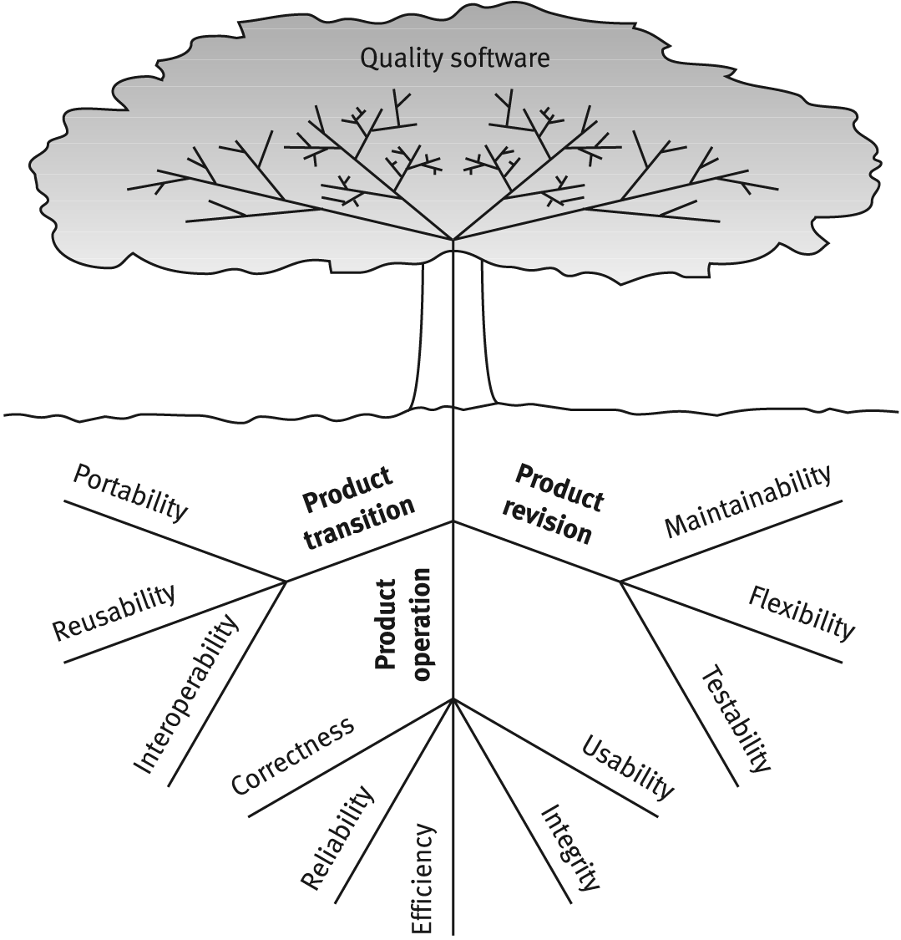
McCall’s factor model tree

Slide 11
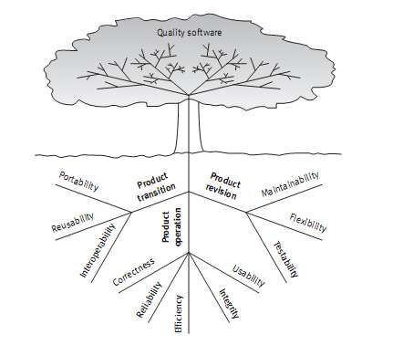
McCall's factor model
Product operation factors:
How well does it run and ease of use
Correctness
Reliability
Efficiency
Integrity
Usability

Slide 12
Correctness
Correctness requirements are defined in a list of the software system’s required outputs
The output mission
Accuracy of output
Completeness of the output information
Up-to-date of the information
Availability of the information
The standard for coding and documenting of software system

Slide 13
Reliability
Reliability requirements deal with failures to provide service. They determine the maximum allowed software system failure rate, and can refer to the entire system or to one or more of its separate functions

Slide 14

Integrity
Integrity requirements deal with the software system security, that is,
requirements to prevent access to unauthorized persons, to distinguish between the majority of personnel allowed to see the information (“read permit”) and a limited group who will be allowed to add and change data (“write permit”), and so forth.

Slide 15
Efficiency
Efficiency requirements deal with the hardware resources needed to perform all the functions of the software system in conformance to all other requirements.
The main hardware resources to be considered are the computer’s processing capabilities (measured in MIPS – million instructions per second ,etc.)

Slide 16
Usability
Usability requirements deal with the scope of staff resources needed to train a new employee and to operate the software system.

Slide 17
McCall’s factor model
Product revision factors
Can I fix it easily, retest, version it, and deploy it easily?
Maintainability,
Flexibility,
Testability

Slide 18

Maintainability
Maintainability requirements determine the efforts that will be needed by users and maintenance personnel to identify the reasons for software failures, to correct the failures, and to verify the success of the corrections.
This factor’s requirements refer to
modular structure of software,
internal program documentation, and
programme r ’s manual, amo ng other item s.

Slide 19

Flexibility
The capabilities and efforts required
To support adaptive maintenance activities are covered by the flexibility requirements.
These include the resources(i.e. in man-days) required to adapt a software package to a variety of customers of the same trade, of various extents of activities, of different ranges of products and so on.
This factor’s requirements also support perfective maintenance activities.

Slide 20
Testability
Testability requirements deal with the testing of an information system as well as with its operation.
Testability requirements for the ease of testing are related to special features in the programs that help the tester, for instance by providing predefined intermediate results and log files.

Slide 21
McCall’s factor model
Product transition factors:
Can I move the app to different hardware? Interface easily with different hardware / software systems; can I reuse major portions of the code with little modification to develop new apps?
Portability,
Reusability,
Interoperability

Slide 22
Portability
Portability requirements tend to the adaptation of a software system to other environments consisting of different hardware, different operating systems.

Slide 23
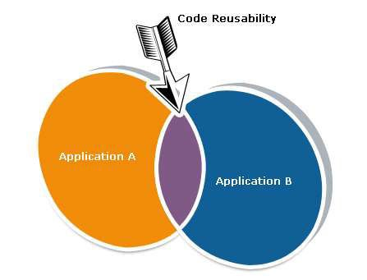
Reusability
Reusability requirements deal with the use of software modules originally designed for one project in a new software project currently being developed.

Slide 24
Interoperability
Interoperability requirements focus on creating interfaces with other software systems or with other equipment firmware (for example, the firmware of the production machinery and testing equipment interfaces with the production control software).
Interoperability requirements can specify the name(s) of the software or firmware for which interface is required. They can also specify the output structure accepted as standard in a specific industry or applications area.

Slide 25

Interoperability revolutionized Healthcare

